Slide 1
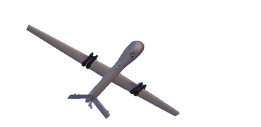
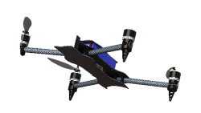
Raptor365
We Deliver

Slide 2
Introduction
Raptor365®
“At Raptor365 we believe our customers can perform efficiently, with lower cost and improved safety by integrating drone technology into their business processes”

Slide 3
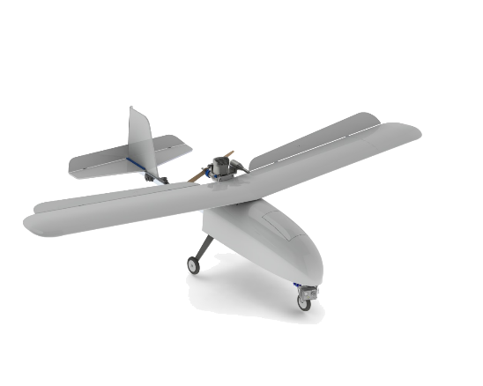
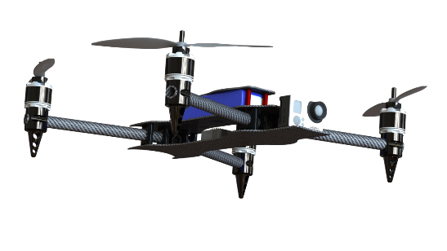
Our Products and Services
Unmanned Aerial Systems provider
Manufacturer and provider of Fixed Wing and MultiRotor UAS
Customized Solutions based on client requirements
Applied for US Federal Aviation Administration(FAA) approval

Slide 4
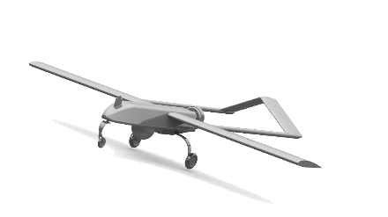
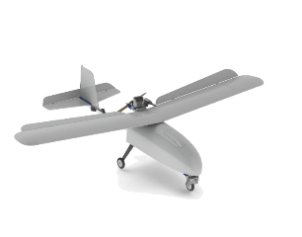
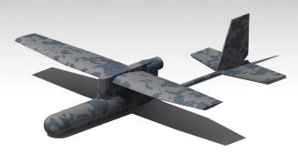
Our Fixed Wing Aeroplanes
Raptor365®
Endurer
Wingspan 3.0 Mtrs
Endurance 1-3 hrs
Range – 40-150 Kms
Total Running Distance (excl 30% reserve) 300 Kms
Weight – 15 Kgs
All Raptor365® Payloads
Raptor365®
Enquirer
Wingspan 2.5 Mtrs
Endurance 1-2 hrs
Range – 15 Kms
Total Running Distance (excl 30% reserve) 35 Kms
Weight – 2.2 Kgs
All Raptor365® Payloads
Raptor365®
Player
Wingspan 900mm
Endurance 20 Min
Range – 1-3 Kms
Total Running Distance (excl 30% reserve) 10 Kms
Weight – 920 Gms
All Raptor365® Payloads

Slide 5
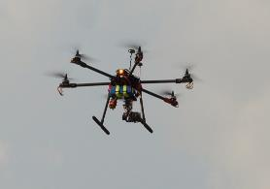
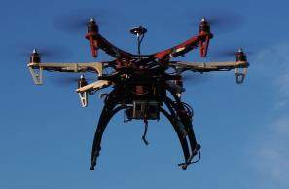
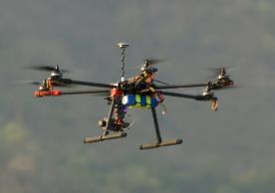
Our MultiRotors
Raptor365®
Hexa700
Wingspan 900 mm
Endurance 25min
Range – 1-3Km
Total Running Distance (excl 30% reserve) 10 Kms
Weight – 3 Kgs
All Paylods of Raptor365®
Raptor365®
Hexa550
Wingspan 550 mm
Endurance 20min
Range – 1-3 Kms
Total Running Distance (excl 30% reserve) 10 Kms
Weight – 1.7 Kgs
All Paylods of Raptor365®
Raptor365®
Quad550
Wingspan 300mm
Endurance 15-17 Min
Range – 1-3 Kms
Total Running Distance (excl 30% reserve) 10 Kms
Weight – 1.3Kgs
All Paylods of Raptor365®

Slide 6
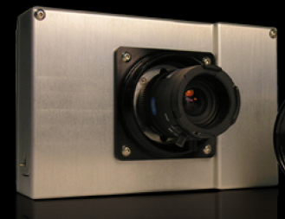
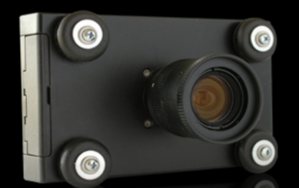
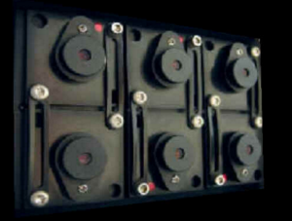
Our Payloads
Raptor365®
Aero
The Aero is a ruggedized single sensor digital multi-spectral camera designed and optimized for capture of visible light wavelengths longer than 520nm and near-infrared wavelengths up to 920nm.
Raptor365®
Light
The ‘Light’ is a lightweight (7 ounce) version of our Aero Camera. Light weight qualifies it as an ideal solution for applications in which weight is a critical factor. ‘Light’ contains a single 3.2 megapixel sensor optimized for capture of visible light wavelengths longer than 520 nm and near-infrared wavelengths up to 920 nm.
Raptor365®
Snap
This is an unique payload due to the user-configurable bands of radiation they are able to sense and the high-resolution multi-spectral images they are able to deliver. Snap is lighter, moe compact and faster than all camera’s of this class in the market.

Slide 7
32. Nuclear Accident - Contamination Tracking & Monitoring
33. Agriculture (Crop Monitoring & Management)
34. Glacier & Ice Cap Monitoring
35. Wildlife Census
36. Aerial Terrain Mapping
37. Digital Elevation Mapping
38.Anti-terrorist operations
39. Criminal Car Tracking
40. Hostile Protest Control
41. Illegal Dumping Control
42. Critical Infrastructure Inspection
43. Forest Fire Fighting (Detection / Monitoring / Support)
44. Regional Surveillance
45. Smuggling control
46. Urban Law Enforcement
47. Fishery Control
48. Nuclear Accident Monitoring
49. Ocean & Sea Research Support
50. Post-Disaster Relief Operations
51. Environmental Monitoring
52. Iceberg Monitoring
53. Common Agricultural Policy Control
54. Road Traffic Surveillance
55. Anti-Piracy Operations
56. Forestry (Tree Illness Monitoring)
57. Critical Infrastructure Surveillance
58. Illegal Immigrant Control
59. Historic Site Control
60. Illegal Logging Control
61. Maritime Surveillance (Sea Lane Surveillance)
1. Anti-looting control
2. Coastal Surveillance
3. Crowd Surveillance
4. Human Trafficking Control
5. Heritage Looting Control
6. Illegal Mining
7. Perimeter Surveillance
8. Perimeter Security
9. Concert / Meeting Surveillance
10. Sporting Events Surveillance
11. Border Surveillance
12. Disaster/Accident Site Monitoring & Mapping
13. Nuclear & Biological Accident - Contamination Measurement
14. Volcanic Ash Cloud (Tracking & Monitoring)
15. Monitoring for Agricultural Selective Harvesting
16. Forestry (Tree Growth Monitoring)
17. Aerial Terrain Mapping (Urban Environment)
18. Forest Fire Operations Support
19. Coastal Surveillance
20. Anti-poaching control
21. Crime Scene Surveillance
22. Fight Against Drugs
23. Illegal Activity Control
24. Illegal Drug Cultivation
25. Illegal Ship Bilge Venting
26. Maritime Surveillance
27. Military & Police Applications
28. Wildlife Crime Control
29. Fire Scene Inspection (Pre / During / Post)
30. Road & Highway Traffic Monitoring
31. Forestry Management & Research
Areas of Employment

Slide 8
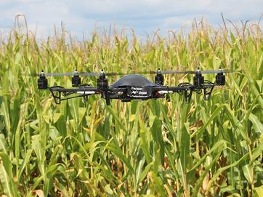
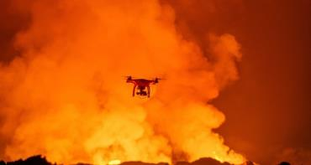
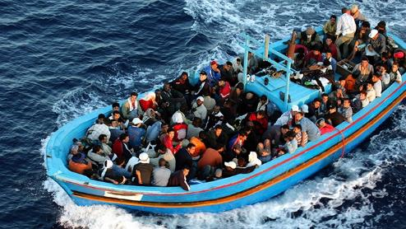
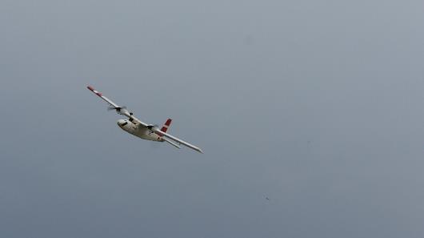
Max coverage with minimum manpower
On call & quick response to all threats
Survey for Port development
A geodetic tool for landfill analysis, tides and sea surge
Disaster management tool
Port & Infrastructure Monitoring

Slide 9
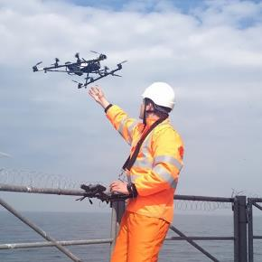
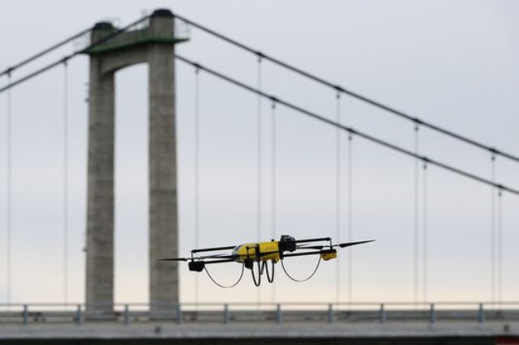
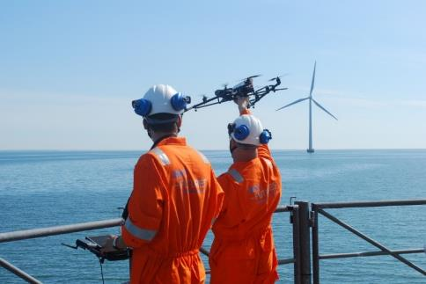
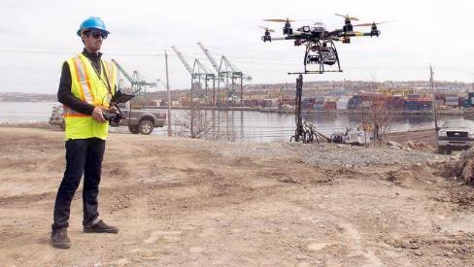
Inspection of a large area of interest
Large area’s can be inspected within a stipulated time
Ability to view inhospitable terrains
Records progress
Management can see real time progress at the site
Port & Infrastructure Monitoring

Slide 10
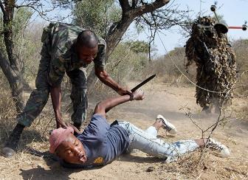
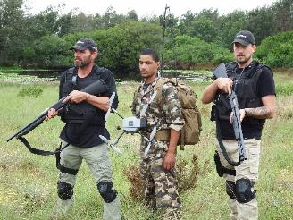
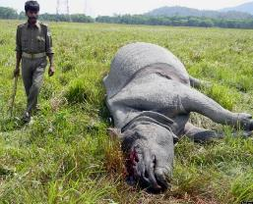
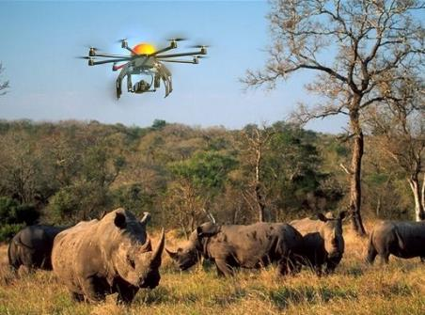
Bird’s eye view of national parks
Co-ordination of anti-poaching operations
Deterrence
Night Observation through
Thermal Payload
IR Payload
Anti Poaching Operations

Slide 11
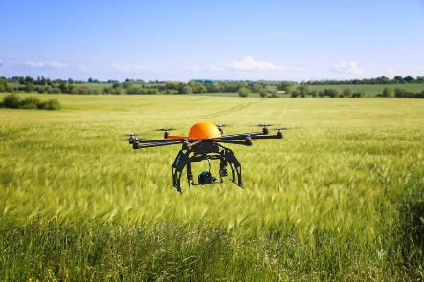
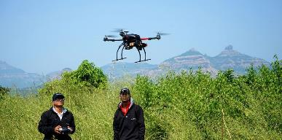



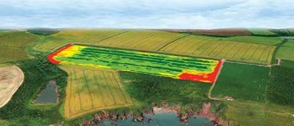
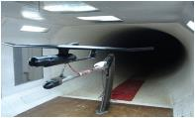
Water quality assessment
Vegetation index calculation
Plant counting & plant health measurement
Water quality assessment
Full spectral sensing
Spectral index research and development
Mineral and surface composition surveys
Agriculture Monitoring

Slide 12
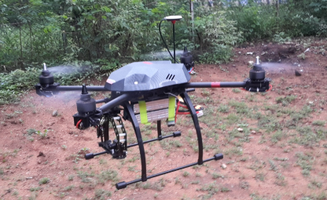
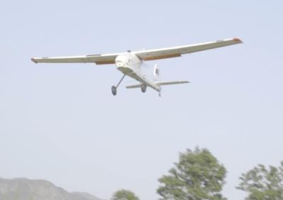
Comparison with similar systems
Military Grade Quality
Competitive Price
Products & solutions
Customized solution / Product
After sales support
Training of crew
Sound technical back up

Slide 13
Competitor Analysis
 | Speed | Battery Life | Range | Cost | Services
DJI | 1x | 2x | 1x | 4x | 1x
3DR | 1x | 1x | 1x | 3x | 2x
Aerovironment | 2x | 2x | 3x | 4x | 4x
Raptor 365 | 3x | 3x | 3x | 2x | 4x

Slide 14
Key Benefits of Product or Service
Raptor365 team has vast expertise in Unmanned systems technology, design & operation, sensor systems, regulatory matters and over 20 years of general aviation experience. We take the following approach to make technology transfer easy for you.
UAS Direct - Offering integrated UAS based on requirement
Select & Build the best airframes and sensors for your specific project(s)
Develop efficient and effective training, flight operations policies and procedures
Arrange for pre and post-flight data processing and analysis
UAS on demand in cloud - Our experts can assist you with incorporating UAS into your operations
Deploy the best airframes and sensors for your specific project(s)
Develop pre-processing of flight data for required operation
Arrange for pre and post-flight data processing and analysis
Store aerial data on cloud based platform for easy access and review, anywhere/anytime

Slide 15
Management Team
Natraj Balasubramanian demonstrates the rare ability to recognize and realize new business opportunities when markets and technologies are in transition. Since the early 2000s, Natraj has founded several tech companies in the USA and emerging markets, namely India and the Philippines. As a serial entrepreneur, aviator, drone enthusiast and businessman he sees great potential for drones and has teamed up with some of the best talent in this field.
Prior to founding Raptor365, Natraj served as CEO of Clerysys Inc. and Nebra Business Solutions. He has extensive experience in aviation having served for nearly a decade in the Indian Air Force in various capacities as a combat aviator after being commissioned in the flying branch. Natraj is an alumnus of the Air Force Academy & Harvard Business School.

Slide 16
Management Team
Varsha Augustine likes to lead from the front. She has been in the drone industry since 1997, having seen great potential for its even then. She has a specialty in Micro Drones and is a frequent keynote speaker as a subject matter expert. Varsha is the Director of AutomicroUAS AeroTech, a micro UAV manufacturing unit. AutomicroUAS is closely associated with the security environment of India. Her team designed several state of the art machines which are flying with Indian Security Forces.
Commissioned in the Indian Air Force as an officer, Varsha was instrumental in IAF going digital in various aspects of operations & maintenance. She is one of the very few female UAV pilots in the world. Varsha is an alumnus of the Air Force Academy & XLRI - Xavier School Of Management.

Slide 17
Management Team
Gusty, is a subject matter expert in the field of UAVs, especially Micro UAVs. He designs UAV around a payload, test flies and fine tunes it with an approach of ‘Right Tool for the Right Job’. His drones are successfully flying in some of the highest battle grounds of the world.
He is an ace fighter pilot and has commanded a frontline fighter squadron. He is also the alumnus of IIM & IIT Kharagpur. Presently, he is pursuing his PhD with a sole aim of bringing robotics & UAVs to replace manned flights.
He frequently writes & blogs on UAVs, aviation & robotics. He is a frequent speaker on aviation and drones.

Slide 18
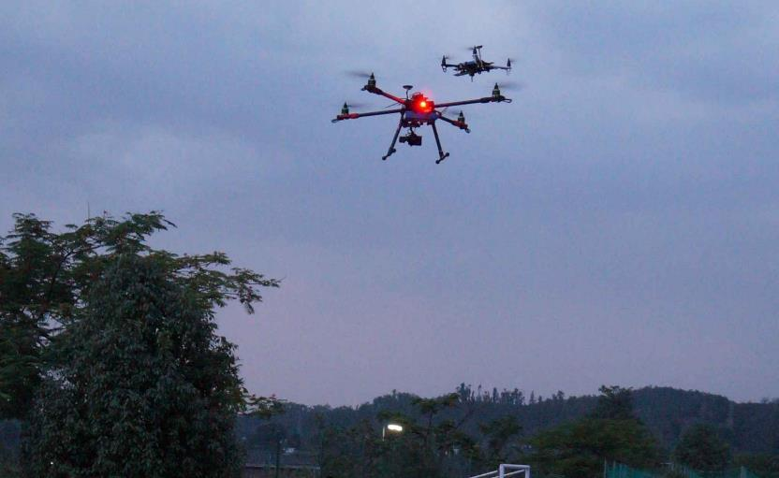
Thanks

